Slide 1
Structured Data

Slide 2
Introduction
This module discusses:
structures which allow you to encapsulate several variables into a single item
enumerated types, which are data types that you can create
dictionaries which are data structures for storing items known as key-value pairs

Slide 3
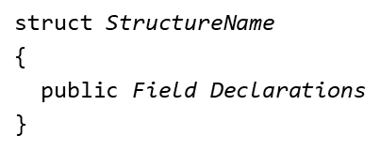
Structures (1 of 2)
You can group several variables together into a single item known as a structure
It allows you to create custom data types for your programs
Each variable in a structure is known as a field
Fields in a structure can be of different data types
The generic form to declare a structure in
where struct is a keyword; public is the access modifier

Slide 4
Structures (2 of 2)
You can declare a structure:
Outside the application's namespace
Inside the application's namespace
Inside a class
Inside another structure

Slide 5
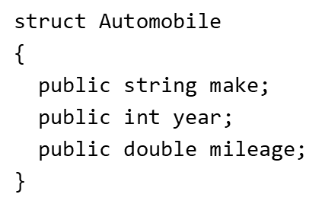
Creating Structures (1 of 2)
For example, a used-car dealer’s application needs the following variables:
string make;
int year;
double mileage;
You can organize them into a structure

Slide 6

Creating Structures (2 of 2)
You then create one or more objects of the structure
Or, use the new keyword to create structure instances

Slide 7
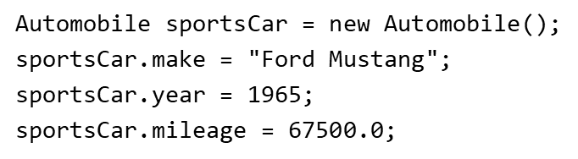
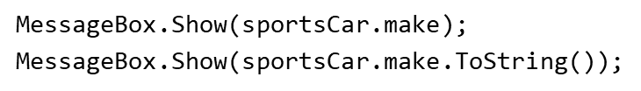

Accessing a Structure’s Fields
You can access a structure’s fields using the dot (.) operator to assign values to or retrieve values from fields
To retrieve values of fields:
You can assign one structure object to another using the assignment (=) operator

Slide 8
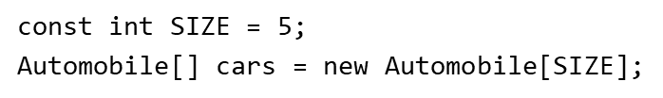

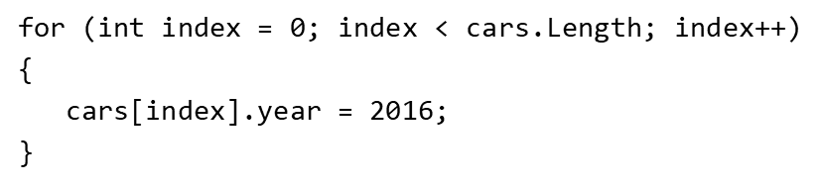
Arrays of Structure Objects (1 of 2)
Structure objects can be stored in an array
To access one object in the array, use the subscript
You can create loops to access the array

Slide 9
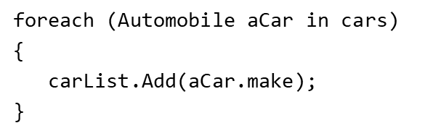
Arrays of Structure Objects (2 of 2)
To store structure object in a List, use:

Slide 10
The DateTime and TimeSpan Structures
In .NET, the DateTime structure stores a date, a time, or both
In .NET, the TimeSpan structure stores information about a time interval

Slide 11
The DateTime Structure
The date and time values are stored internally as:
Month: an integer in the range of 1 – 12
Day: an integer in the range of 1 – 31
Year: an integer in the range of 1 – 9999
Hour: an integer in the range of 0 – 23
Minute: an integer in the range of 0 – 59
Second: an integer in the range of 0 – 59
Millisecond: an integer in the range of 0 - 999

Slide 12
Create an Instance of the DateTime Structure
The following creates an instance of the DateTime structure named dt, set to the default date of January 1, 0001, 12:00:00 AM, 0 milliseconds:
DateTime dt = new DateTime();
To change individual date and time properties use:
Datetime dt = new DateTime();
dt.Month = 12;
dt.Day = 15;
dt.Year = 2019;
dt.Hour = 13;
dt.Minute = 30;
dt.Second = 0;
dt.Millisecond = 0;
Now dt is set to December 15, 2019 at 1:30:00 PM

Slide 13
Dealing with the DateTime Structure
To display the current date and time:
DateTime currentDateTime = DateTime.Now;
To convert a string to a DateTime structure:
Datetime.TryParse(string, out targetVariable)
DateTimePicker control (in Toolbox’s Common Controls group) allows user to select dates
Can compare DateTime objects using relational operators. For example: obj1 > obj2 will be true if obj1 is later than obj2 and obj1 < obj2 will be true if obj1 is earlier than obj2 and so on

Slide 14
The TimeSpan Structure (1 of 2)
Allows you to create objects that store data about an amount of time, such as 9 days or 12 hours using the following properties:
Days: an integer, positive or negative
Hours: an integer in the range of -23 through 23
Minutes: an integer in the range of -59 through 59
Seconds: an integer in the range of -59 through 59
Milliseconds: an integer in the range of -999 through 999
To create an instance of the TimeSpan structure named tspan:
TimeSpan tspan = new TimeSpan();

Slide 15
The TimeSpan Structure (2 of 2)
To change individual date and time properties use:
TimeSpan tspan = new TimeSpan();
tspan.Days = 15;
tspan.Hours = 6;
tspan.Minutes = 30;
tspan.Seconds = 10;
tspan.Milliseconds = 500;
Now the tspan object is set to 15 days, 6 hours, 30 minutes, 10 seconds, and 500 milliseconds

Slide 16
Performing Math with DateTime and TimeSpan Objects
You can add or subtract a TimeSpan object to or from a DateTime object to get another DateTime object
Example: create and add a TimeSpan object that represents 10 days to a DateTime object:
//Create a DateTime object for August 15, 2024
DateTime dt = new DateTime(2024, 8, 15);
//Create a TimeSpan object for 10 days
TimeSpan tspan = new TimeSpan(10, 0, 0, 0);
//Add the TimeSpan object to the DateTime object
DateTime futureDate = dt + tspan;
Now the futureDate object is set to August 25, 2024

Slide 17
Enumerated Types (1 of 6)
An enumerated data type is a programmer-defined data type
It consists of predefined constants known as enumerators
Enumerators represent integer values
When you create an enumerated data type, you specify a set of symbolic values that belong to the data type
An enumerated data type declaration begins with the enum keyword, followed by the name of the type, followed by a list of identifiers inside the braces

Slide 18
Enumerated Types (2 of 6)
enum Day { Sunday, Monday, Tuesday, Wednesday, Thursday, Friday, Saturday }
Inside the braces, each identifier (such as Monday) is an enumerator
Enumerators are constants that represent integer values.
The value of Day.Sunday is 0, Day.Monday is 1, etc.

Slide 19
Enumerated Types (3 of 6)
An enumerator declaration can appear:
Outside the application’s namespace
Inside the application’s namespace
Inside a class
Once you have created an enumerated data type, you can declare variable of that type:
Day workDay;

Slide 20
Enumerated Types (4 of 6)
To assign the value Day.Monday to the workDay variable, use:
workDay = Day.Monday;
Enumerators and enum variables also support the ToString method

Slide 21

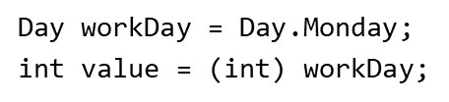
Enumerated Types (5 of 6)
Enumerators are integers, but you cannot directly assign an enumerator to an int variable. You need to use a cast operator.
An enum variable can be converted to int

Slide 22
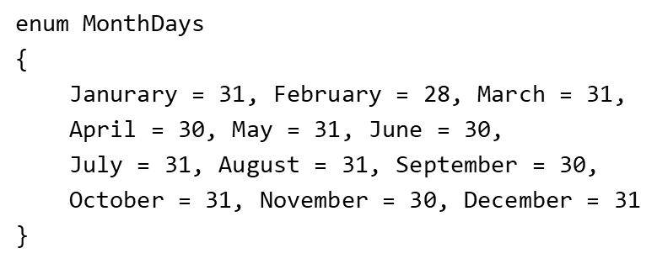
Enumerated Types (6 of 6)
You can specify default values to enumerators

Slide 23
Dictionaries
A dictionary is an object that stores a collection of data
Each element has two parts: a key and a value
Each key is associated with a specific value and the key is used to locate that value
These are called key-value pairs

Slide 24
The Dictionary Class
.NET provides a Dictionary class that is used to implement a dictionary container
General format to declare a Dictionary object: Dictionary<KeyType, ValueType> Dname = new Dictionary<KeyType, ValueType>();
Where:
KeyType is the data type of each element’s key
ValueType is the data type of each element’s value
Dname is the name of the Dictionary

Slide 25
Initializing a Dictionary
Example code:
Dictionary<int, string> employees = new Dictionary<int, string>()
{
{101, "Chris Jones"},
{102, "Jessica Smith"},
{103, "Amanda Stevens"},
{104, "Will Osborn"}
};

Slide 26
Adding an Element to a Dictionary
General Format:
dictionaryName[key] = value;
Example:
Dictionary<int, string> employees = new Dictionary<int, string>();
employees[105] = "Beth Young";
employees[106] = "Jake Brown";
Using the Add Method:
Dictionary<int, string> employees = new Dictionary<int, string>();
employees.Add(105, "Beth Young");
employees.Add(106, "Jake Brown");

Slide 27
Retrieving Values From a Dictionary
General Format:
dictionaryName[key]
To display the elements of the employees dictionary shown on the previous slide:
for (int key = 101; key < 105; key++)
{
employeesListBox.Items.Add(employees[key]);
}
Removing elements:
employees.Remove(105);
This will remove the value which has key = 105 (e.g., Beth Young will be removed)

Slide 28
Retrieving Values With the TryGetValue Method
General Format:
dictionaryName.TryGetValue(key, out targetVariable)
This method returns true if the element is found
Example code using the employees dictionary from previous slides:
//Search for employee 104
if (employee.TryGetValue(104, out name))
{
MessageBox.Show(name);
}
else
{
MessageBox.Show("Employee 104 was not found.");
}

Slide 29
The Count and ElementAt Properties
Dictionary objects have a Count property that is set to the number of elements in the Dictionary
The Count property is used with the ElementAt property to iterate over elements in a Dictionary using a for loop
General format:
for (int i = 0; i < employees.Count; i++)
{
//Get a keyValuePair element
var element = employees.ElementAt(i);
//Display the element
employeesListBox.Items.Add(element.Key + " " +
element.Value);
}

Slide 30
Tuples
A tuple is a container that can hold multiple pieces of data.
The items in a tuple can be of the same data type, or different data types.
You create a tuple by enclosing a comma-separated list of items in a set of parentheses.
Examples:
var product = (123, "USB Cable", 9.99m);
var sequence = (1, 2, 3, 4);

Slide 31
Tuple Fields
The data items stored in a tuple are known as fields.
By default, the names of the fields are Item1, Item2, Item3, and so on.
You can use these field names to access a tuple's fields:
var product = (123, "USB Cable", 9.99m);
MessageBox.Show(product.Item1.ToString());
MessageBox.Show(product.Item2);
MessageBox.Show(product.Item3.ToString());

Slide 32
Declaring a Tuple Variable
If you have an initialization value, you can use the var keyword to declare a tuple variable within a method: var sequence = (1, 2, 3, 4);
If you do not have an initialization value, or you want to declare a tuple variable at the class level, use syntax such as the following: (int, string) t;
This statement declares a tuple variable named t. The data type is (int, string). Item1 is an int and Item2 is a string.

Slide 33
Returning a Tuple From a Method
By returning a tuple, a method can return more than one value.
Example:
private (int, string, decimal) getProduct()
{
return (123, "USB Cable", 9.99m);
}
An example of how we might call the method and assign its return value to a variable:
var product = getProduct();
Or
(int, string, decimal) product = getProduct();

Slide 34
Named Fields (1 of 2)
You can specify your own names for a tuple's fields.
Example:
var name = (FirstName: "Anjali", LastName: "Kumar");
MessageBox.Show($"{name.FirstName} {name.LastName}");
Example of declaring a tuple variable with named fields:
(string FirstName, string LastName) name;

Slide 35
Named Fields (2 of 2)
Here is an example of a method that returns a tuple with named fields:
private (int ID, string Description, decimal Price) getProduct()
{
return (123, "USB Cable", 9.99m);
}
Example of calling the above method and using its return value:
var product = getProduct();
MessageBox.Show($"{product.ID}");
MessageBox.Show($"{product.Description}");
MessageBox.Show($"{product.Price}");

Slide 36
Deconstructing a Tuple
Deconstruction is a syntax that allows you to extract all of a tuple's fields into separate variables.
Look at the following method that returns a tuple:
private (int, string) getInfo()
{
return (100, "Olivia");
}
The following statement uses deconstruction to call the method and extract the values of the returned tuple into separate variables:
(int number, string name) = getInfo();
After this statement executes, the number variable will be assigned 100 and the name variable will be assigned "Olivia".

Slide 37
Tuple Assignment
You can assign one tuple to another as long as both tuples have the same number of fields, and the data types of the tuple's corresponding fields are compatible.
Example:
// Initialize a tuple variable.
var tuple1 = (99, "macaroni", 4.99m);
// Declare a tuple variable.
(int, string, decimal) tuple2;
// Assign tuple1 to tuple2.
tuple2 = tuple1;

Slide 38
Changing the Value of a Field
You can change the value of a tuple's field by assigning a new value to it.
Example:
var point = (100, 200);
// The following statement displays 100, 200
MessageBox.Show($"{point.Item1}, {point.Item2}");
point.Item1 = 0;
point.Item2 = 0;
// The following statement displays 0, 0
MessageBox.Show($"{point.Item1}, {point.Item2}");

Slide 39
Comparing Tuples for Equality and Inequality
You can use the == and != operators to compare tuples.
To use these operators, two tuples must be comparable.
The two tuples are comparable if both tuples have the same number of fields, and the data types of the tuple's corresponding fields are comparable.
Example:
var tuple1 = (10, "Cheese pizza", 9.99m);
var tuple2 = (20, "Ramen noodles", 4.99m);
if (tuple1 == tuple2)
MessageBox.Show("The two are the same.");
else
MessageBox.Show("The two are not the same.");

Slide 40
Inferred Field Names
If a tuple does not have named fields, and it is initialized with the values of named variables, the C# compiler will infer field names from the names of the variables.
Example:
int id = 99;
string name = "Olivia";
var info = (id, name);
MessageBox.Show($"{info.id} {info.name}");

